Slide 1
NICA collider complex at JINR:
challenges and perspectives
G.Trubnikov, I.Meshkov
on behalf of the team
RT-6 Italy-JINR, Dubna, 04/03/14
1

Slide 2



Au x Au collisions
The First Proposals:
Towards Searching for A Mixed Phase of Strongly Inteacting QCD Matter
at The JINR Nuclotron
A.N. Sissakian, A.S. Sorin, M.K. Suleymanov, V.D. Toneev, and G.M. Zinovjev
arXiv:nucl-ex/0601034 v1 24 Jan 2006
A.N. Sissakian, A. S. Sorin, and V. D. Toneev
Proc. of the 33rd Intern. High Energy Physics conference, ICHEP’06,
Moscow, Russia 1, 421 (2006), nuclth/0608032
An optimal way to reach
the highest possible baryon density is
heavy ion collision at √S_{NN} = 4 - 11 GeV/u

Slide 3
Colliders and fixed target experiments
Fixed target experiment: a particle beam extracted from an accelerator bombards an immovable (“fixed”) target
Both primary particles and generated in collision with fixed target move with the speed of the center of the mass in direction of primary (bombarding) particle!
Colliding beams
NICA Project at JINR Igor Meshkov 16th Lomonosov Conference LMSU 23 August, 2013

Slide 4
Collider vs Fixed target
Center of mass energy (√S)
 | Collider | Fixed target
Accurate formulae
Similar particles (symmetric)
Ultra-relativistic case
SIS300: Bρ = 300 Т⋅m, E_{Au} = 36 GeV/u Е_{cm} ~ 8 GeV/u
Nuclotron: Bρ = 45 Т⋅m, E_{Au} = 5.5 GeV/u Е_{cm} ~ 3.3 GeV/u
NICA: Bρ = 45 Т⋅m, E_{Au} = 5.5 GeV/u Е_{cm} ~ 11 GeV/u
RHIC: Bρ ~ 130 Т⋅m, E_{Au} = 100 GeV/u Е_{cm} ~ 14 GeV/u

Slide 5
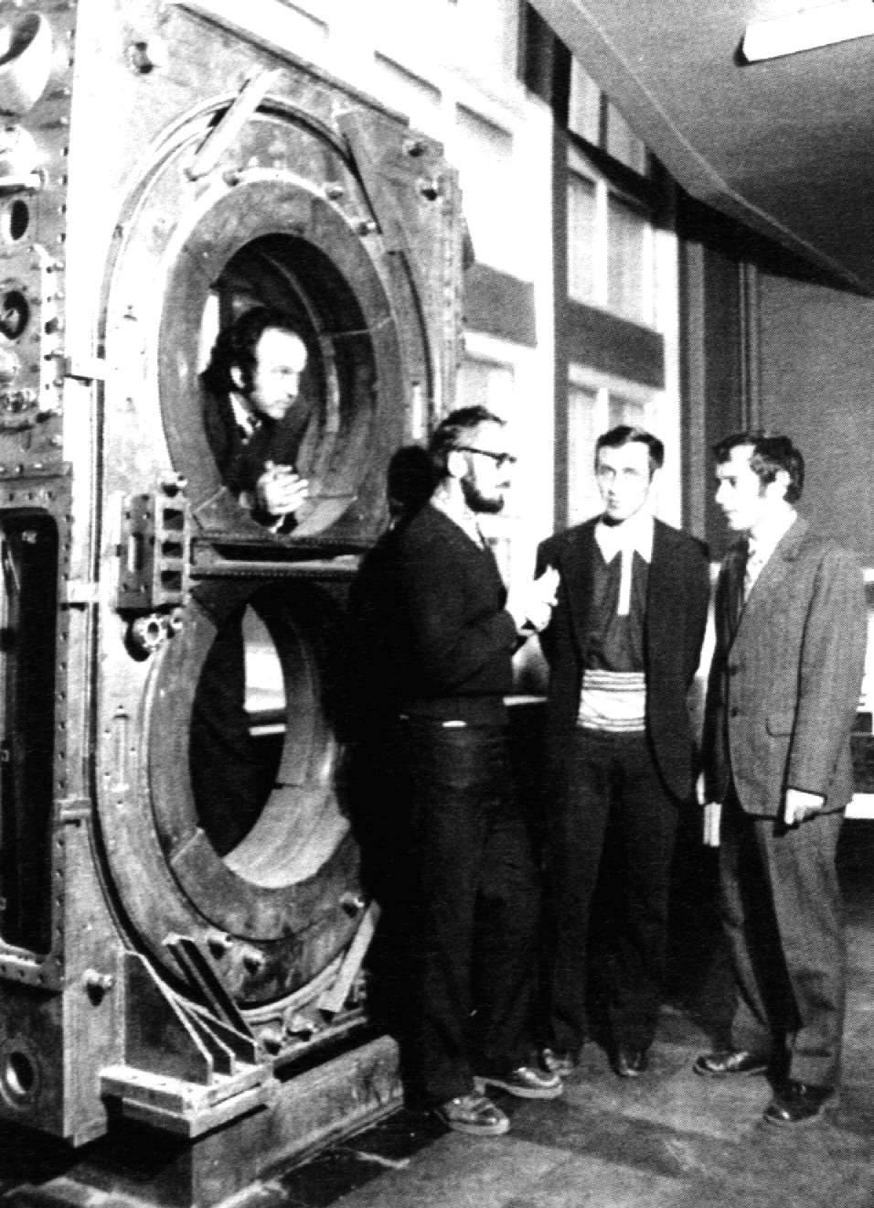
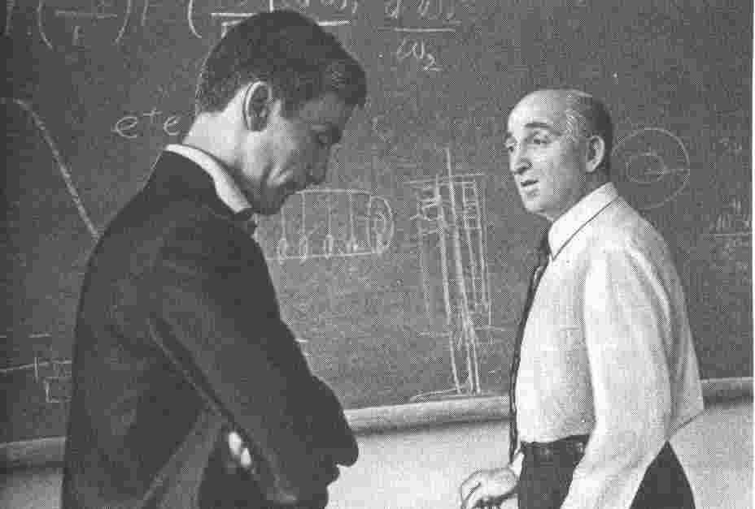

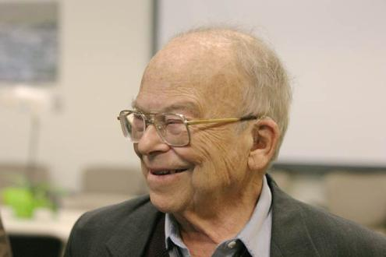
Colliders and fixed target experiments
History of colliding beams
1956, D.W.Kerst et al., – First proposal, pp collider
1958 - 1965 VEP, INP at Novosibirsk
G.Budker, A.Naumov, A.Skrinsky, S.Popov, V.Sidorov, G.Tumaikin et al.
e⁻e⁻, 2 x 160 MeV,
L = 3⋅10²⁷ cm⁻²⋅s⁻¹
1958 - 1965 SLAC
Princeton-Stanford group:
G. K. O'Neill, B.Richter et al.
e⁻e⁻ collider 2 x 500 MeV
G.K.O'Neill
Wolfgang ("Pief") Panofsky

Slide 6
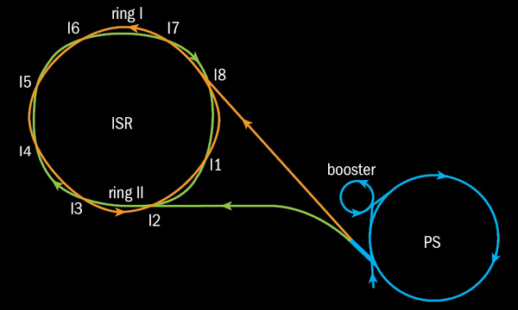
Parameters and luminosity calibration: ISR
beam energy (p): 31 GeV
proton-proton collider and proton-antiproton collider
two separate beam pipes – different orbits for the two beams
coasting beams (no bunches)
collision at large angle in horizontal plane
beam current of up to 40A
very large beams (size in the order of cm)
beam separation with magnets
calibration done for proton-proton and proton-antiproton collisions

Slide 8
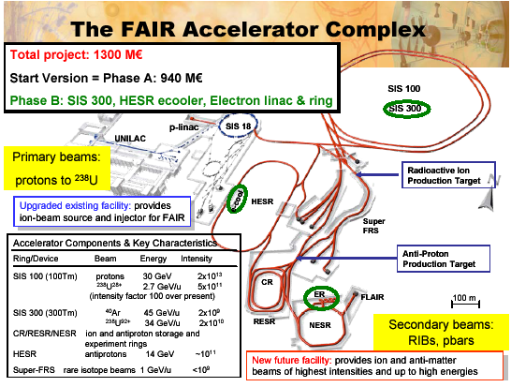

Slide 9
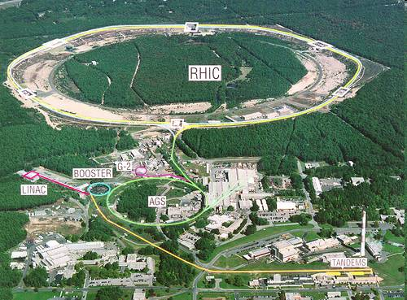

Slide 10
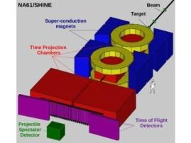
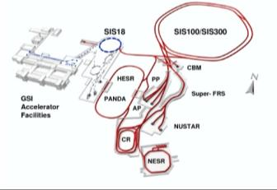
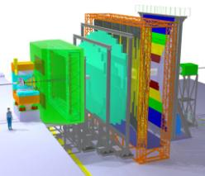

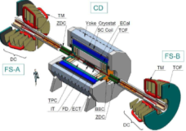
2nd generation HI experiments
STAR/PHENIX @ BNL/RHIC.
designed for high energy researches (√s_{NN} > 20 GeV),
low luminosity for LES program L<10²⁶ cm⁻²s⁻¹ for Au⁷⁹⁺
NA61 @ CERN/SPS.
Fixed target, non-uniform acceptance, few energies
(10,20,30,40,80,160A GeV), poor nomenclature of
beam species
3nd generation HI experiments
CBM @ FAIR/SIS-100/300
Fixed target, E/A=10-40 GeV, high luminosity
MPD & SPD @ JINR/NICA.
Collider, small enough energy steps in the range
√s_{NN} = 4-11 GeV, a variety of colliding systems,
L~10²⁷ cm⁻²s⁻¹ for Au⁷⁹⁺
Notes:
10

Slide 11
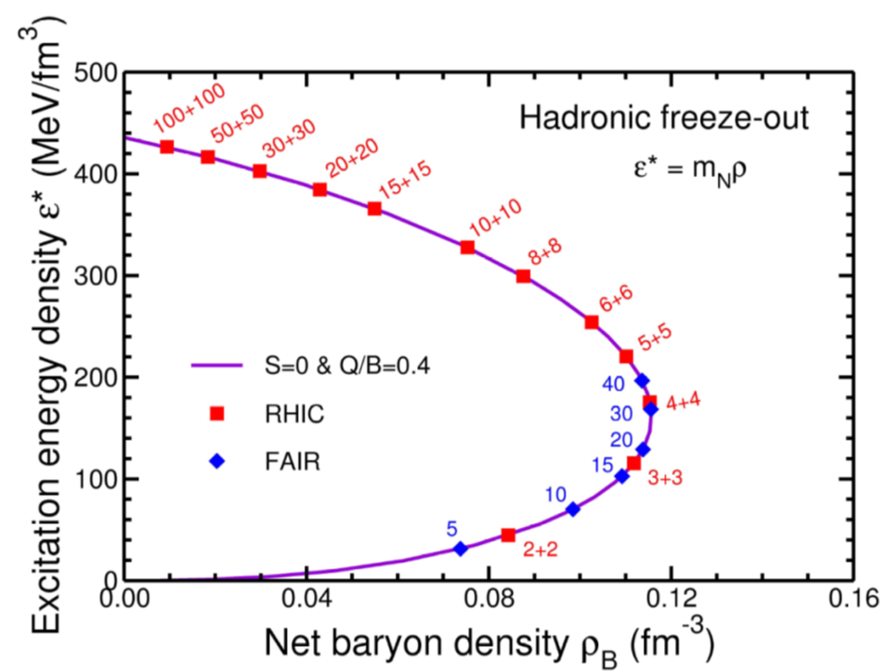
Colliders and fixed target experiments
Baryon density in Au + Au collisions
at √S_{NN} = 4 - 11 GeV/u
E1+E2: collider
E: Fixed Target
J.Randrup,
J.Cleymans
PR C74 (2006)
047901
RHIC
SPS
Collider
fixed target
NICA/MPD
SIS-300 (FAIR)
SIS-100
Nuclotron / BMN

Slide 12
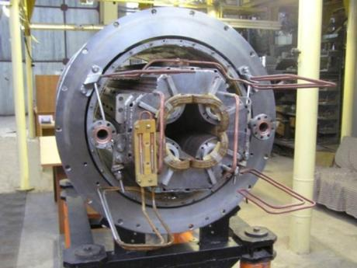
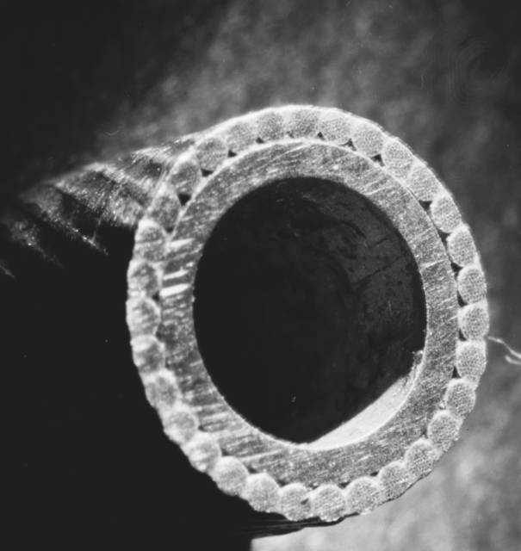
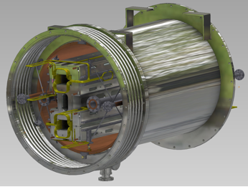
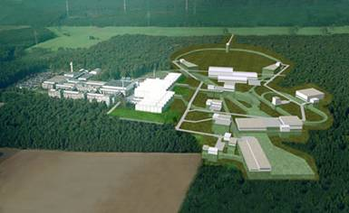
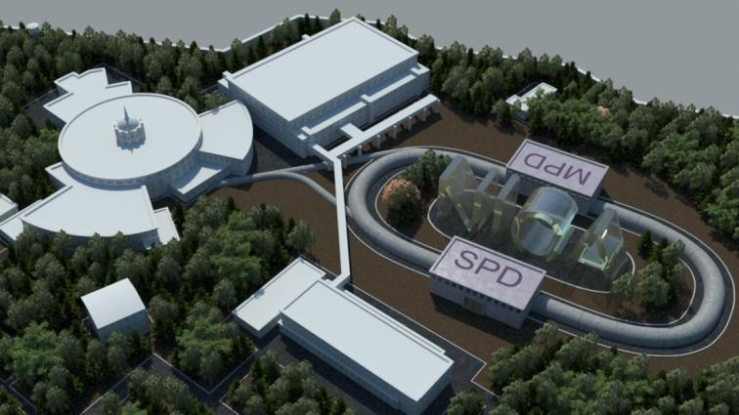
Unique Dubna technologies of fast-cycling superconducting magnets tested during several tens of Nuclotron runs and chosen as basic for accelerator complexes NICA and FAIR
Common European Research infrastructure for Heavy Ion High Energy Physics: NICA + FAIR
Notes:
12

Slide 13

NICA goals
1a) Heavy ion colliding beams 197Au79+ x 197Au79+ at
√s_{NN} = 4 ÷ 11 GeV (1 ÷ 4.5 GeV/u ion kinetic energy )
at L_{average}= 1x10²⁷ cm⁻²⋅s⁻¹ (at √s_{NN} = 9 GeV)
1b) Light-Heavy ion colliding beams of the same energy range and L
2) Polarized beams of protons and deuterons in collider mode:
p↑p↑ √s_{pp} = 12 ÷ 27 GeV (5 ÷ 12.6 GeV kinetic energy )
d↑d↑ √s_{NN} = 4 ÷ 13.8 GeV (2 ÷ 5.9 GeV/u ion kinetic energy )
L_{average} ≥ 1x10³⁰ cm⁻²⋅s⁻¹ (at √s_{pp} = 27 GeV)
3) The beams of light ions and polarized protons and deuterons for fixed target experiments:
Li ÷ Au = 1 ÷ 4.5 GeV /u ion kinetic energy
p, p↑ = 5 ÷ 12.6 GeV kinetic energy
d, d↑ = 2 ÷ 5.9 GeV/u ion kinetic energy
4) Applied research on ion beams at kinetic energy
from 0.5 GeV/u up to 12.6 GeV (p) and 4.5 GeV /u (Au)

Slide 14
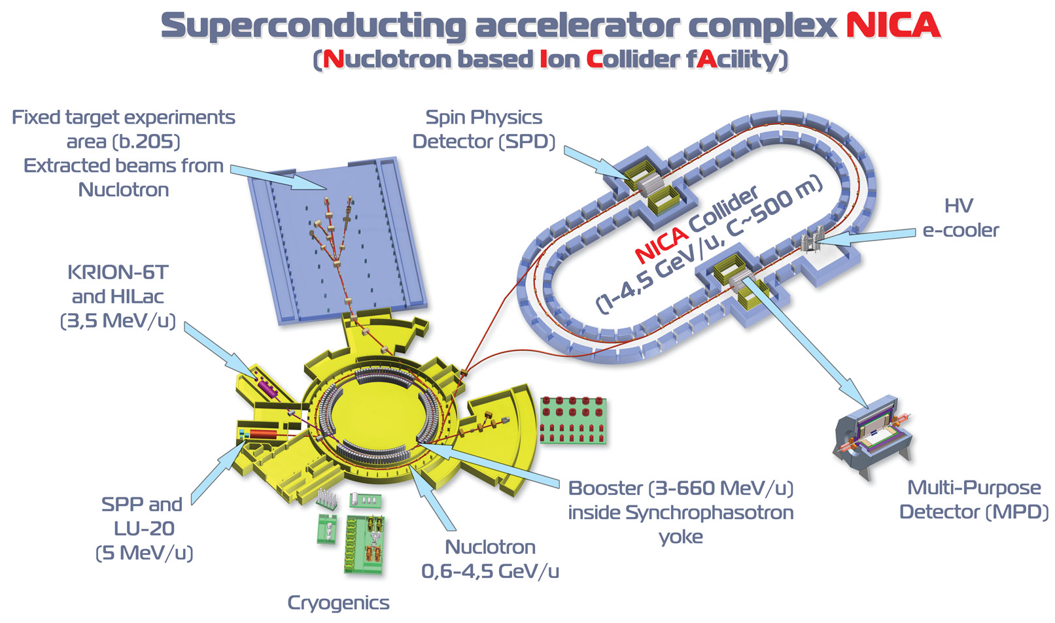
2nd IP
Notes:
14

Slide 15
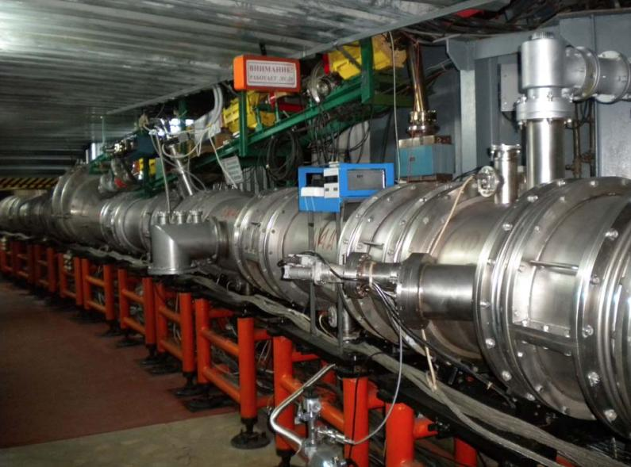
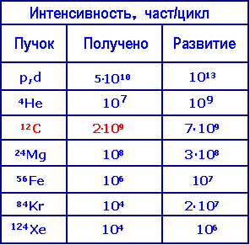
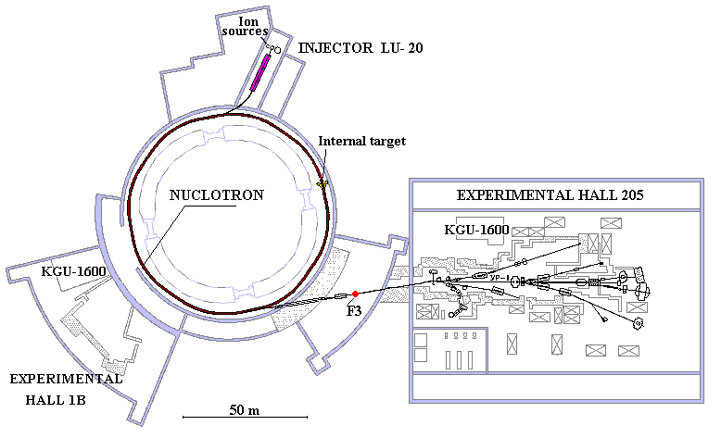
NICA: Nuclotron based Ion Collider fAcility
Routine
beam extraction at 5.2 GeV/u
Acceleration up to 5.8 GeV/u (C6+)

Slide 16
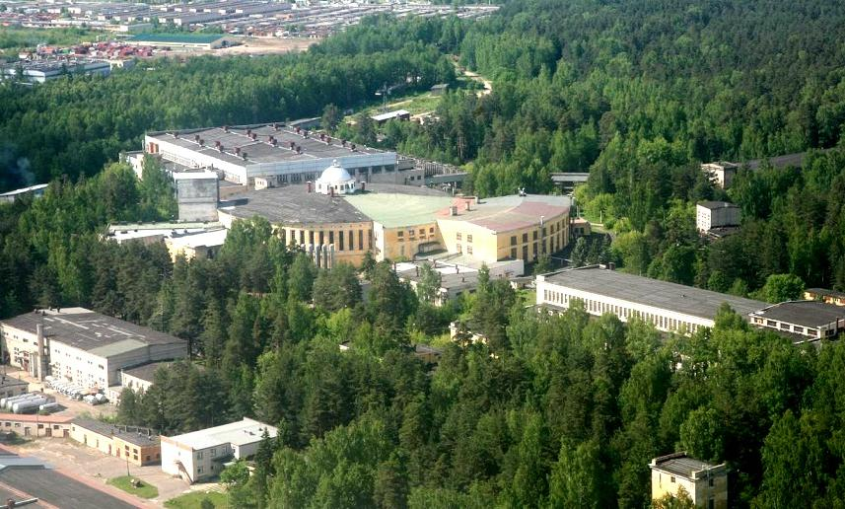
Veksler & Baldin Laboratory of High Energy Physics, JINR
accelerator facility
SPD
X
extracted beam area
Collider
X
MPD
New Linac
Booster
Lu 20
Nuclotron

Slide 17
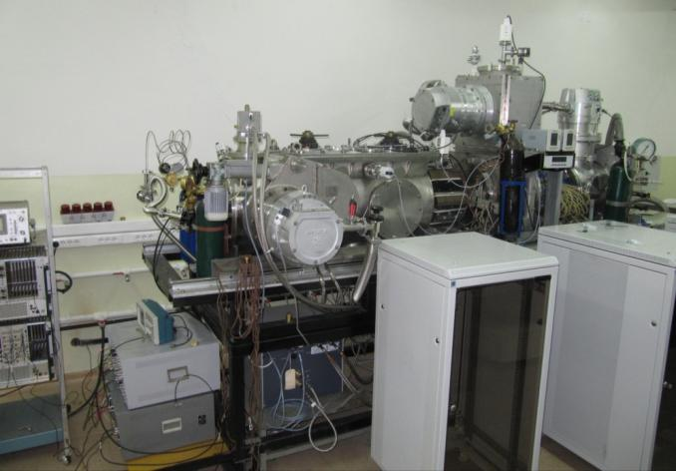
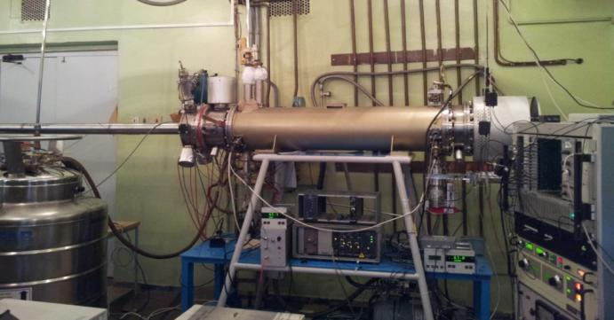
Progress in ion sources development and commissioning
Source for polarized particles (SPP)
Heavy ion source: Krion-6T ESIS
B= 5.4 Tesla magnetic field reached in a robust regime. Full-scale tests of new ESIS in reflex mode of operation was started in spring 2013.
Source is assembled in 2013
and works on its commissioning had been started in June 2013. The goal is to get 10¹⁰ deuterons per pulse.
Test gold ion beams have been produced:
- Au³⁰⁺ ÷ Au32³²⁺, 6⋅10⁸, T_{ioniz}= 20 ms for
Au³²⁺ -> repetition rate 50 Hz.
- ion beams Au⁵¹⁺ ÷ Au⁵⁴⁺ are produced.
Now the goal is: production of Au⁶⁵⁺ ÷ Au⁶⁹⁺
ion beams for their possible injection into
LU-20 -> Nuclotron in spring 2014.
17

Slide 18
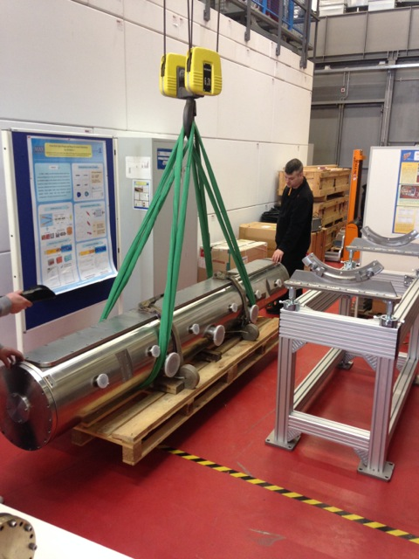
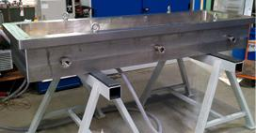

Slide 19
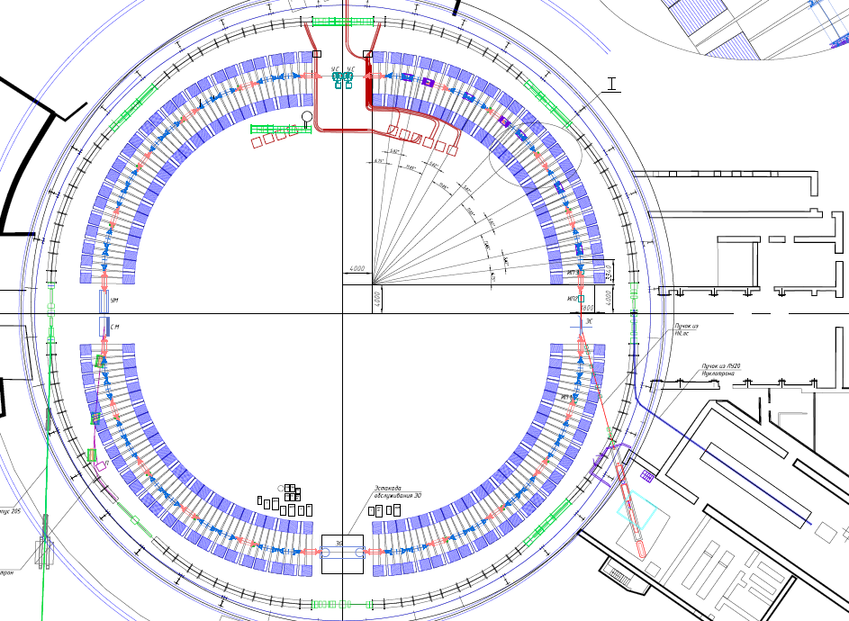
Booster synchrotron
RF
Satellite refrigerator,
Measurement period,
Energy evacuation
Extraction
to Nuclotron
Injection
from HILac
Electron cooling
LU20
HILac
19

Slide 20
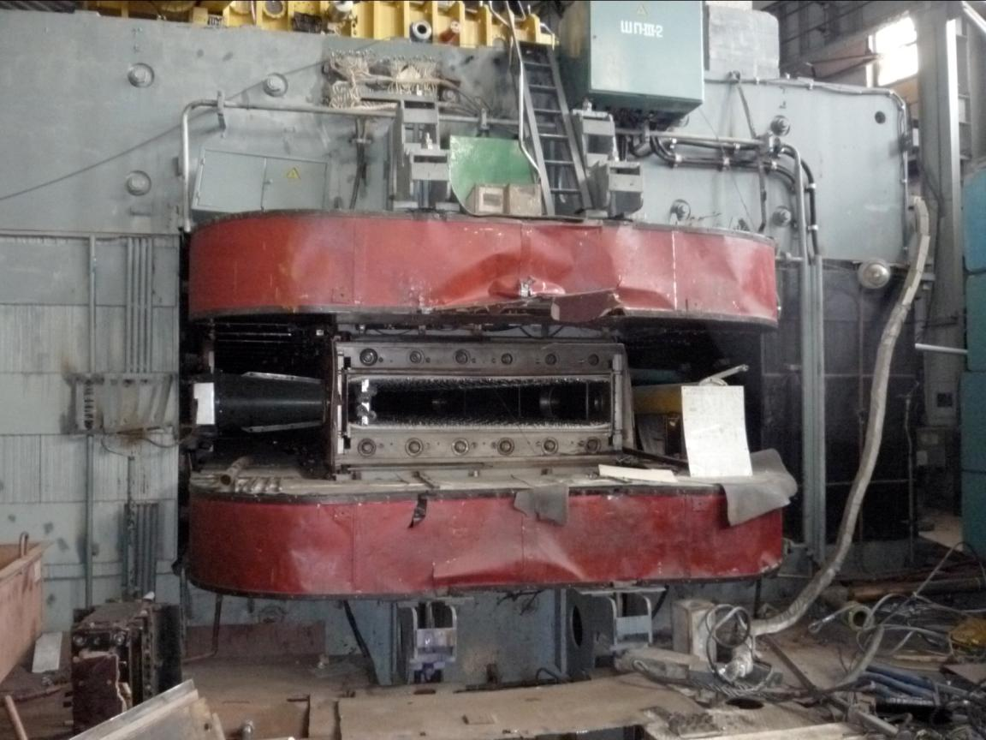
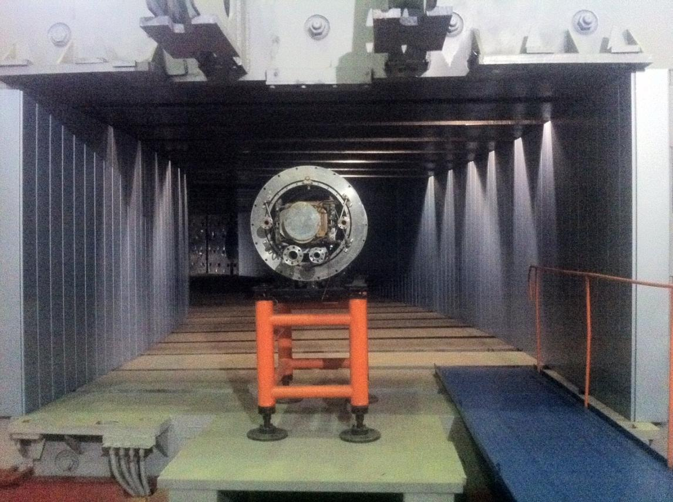
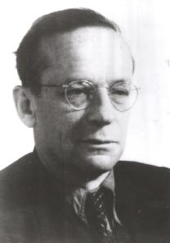
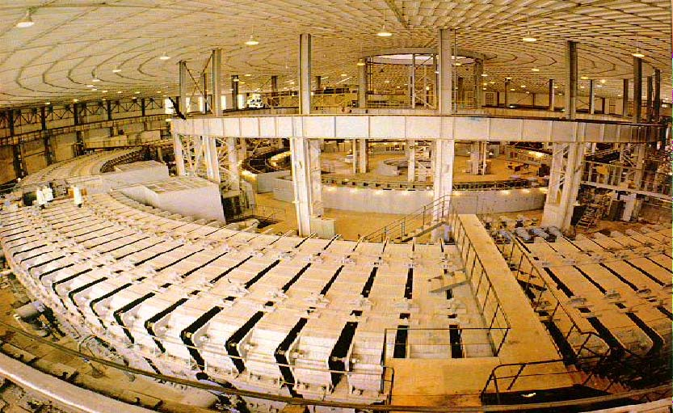
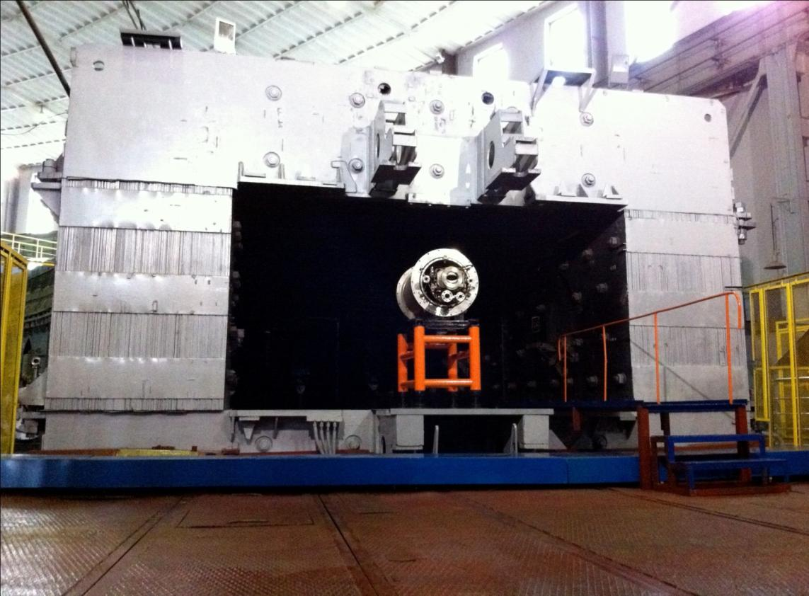
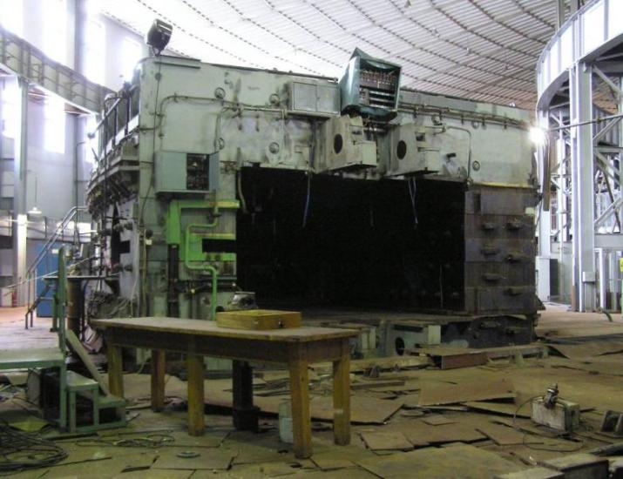
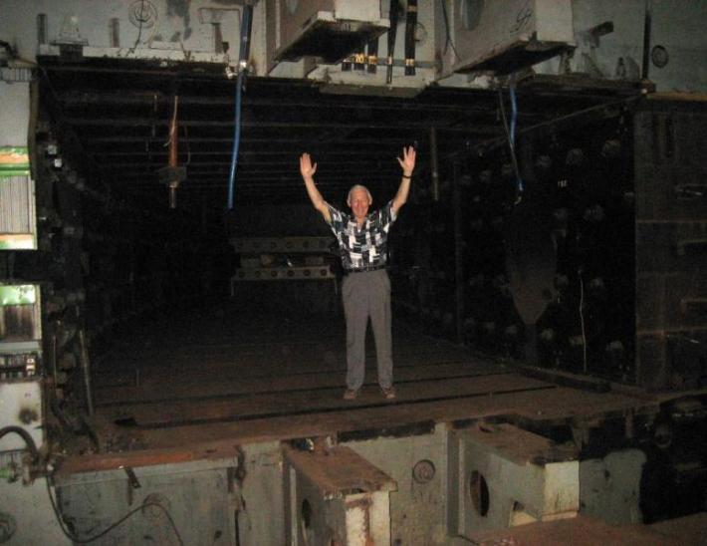
NICA Booster synchrotron
The best method to measure phase space size
В.И.Векслер
Prototype of the Booster dipole
2.3 m
4.0 m
Tunnel preparation

Slide 21
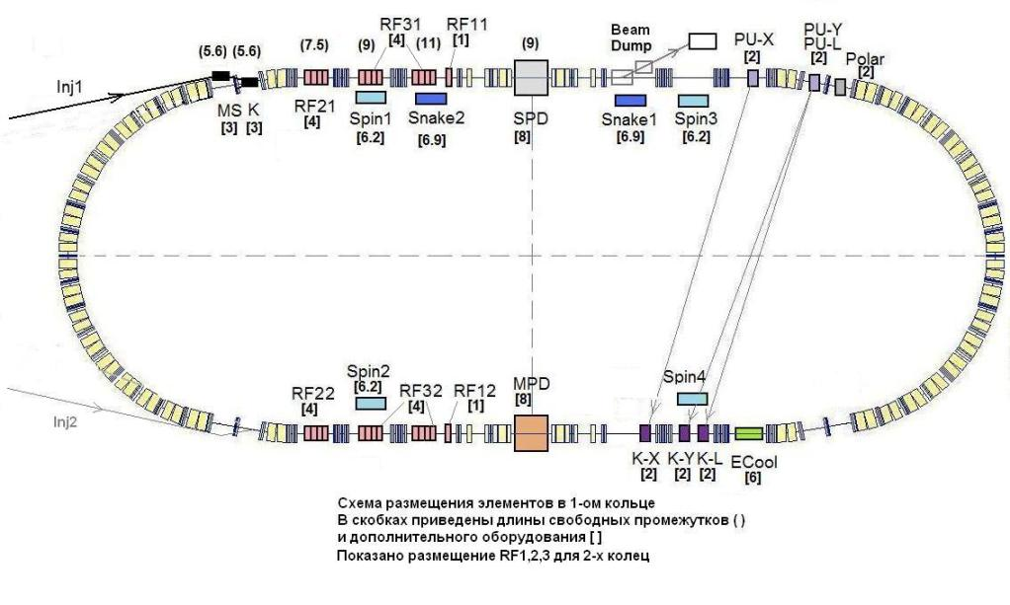
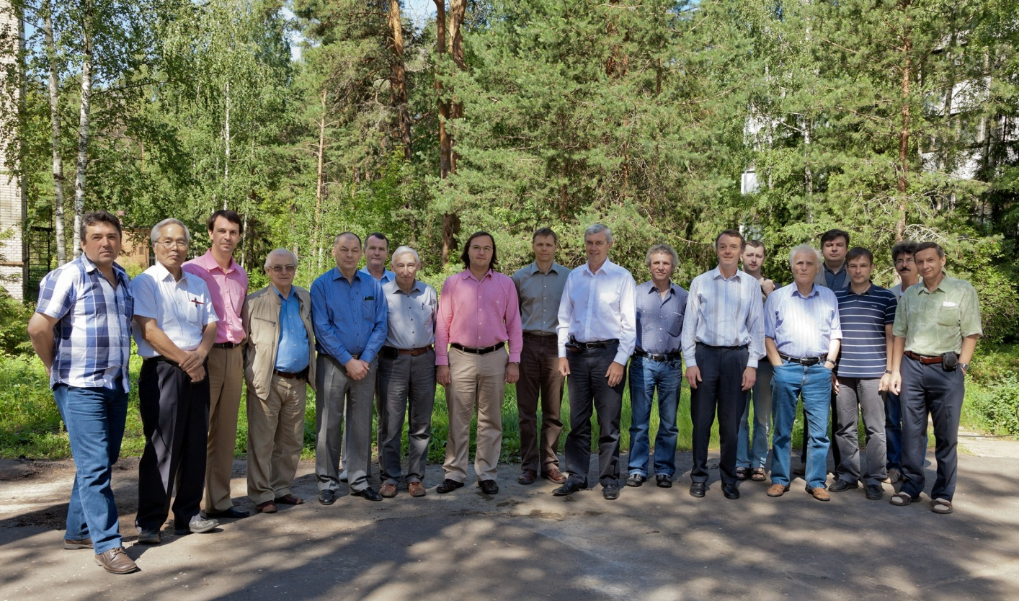
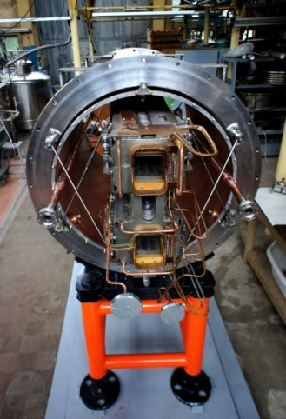
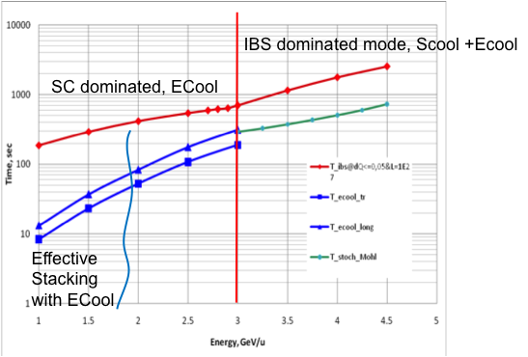
Unique low energy (1-4.5 GeV/u) collider with extremely high luminosity L=1e27
Fruitful collaboration between JINR, FNAL, BNL, FZJ, CERN:
- beam dynamics, tracking;
- electron clouds effect;
- beam stacking and cooling;
- lattice expertise;
FODO structrure
To reach maximum peak luminosity:
minimum beta function in the IP;
maximum bunch number;
maximum bunch intensity;
minimum beam emittance;
minimum bunch length.

Slide 22
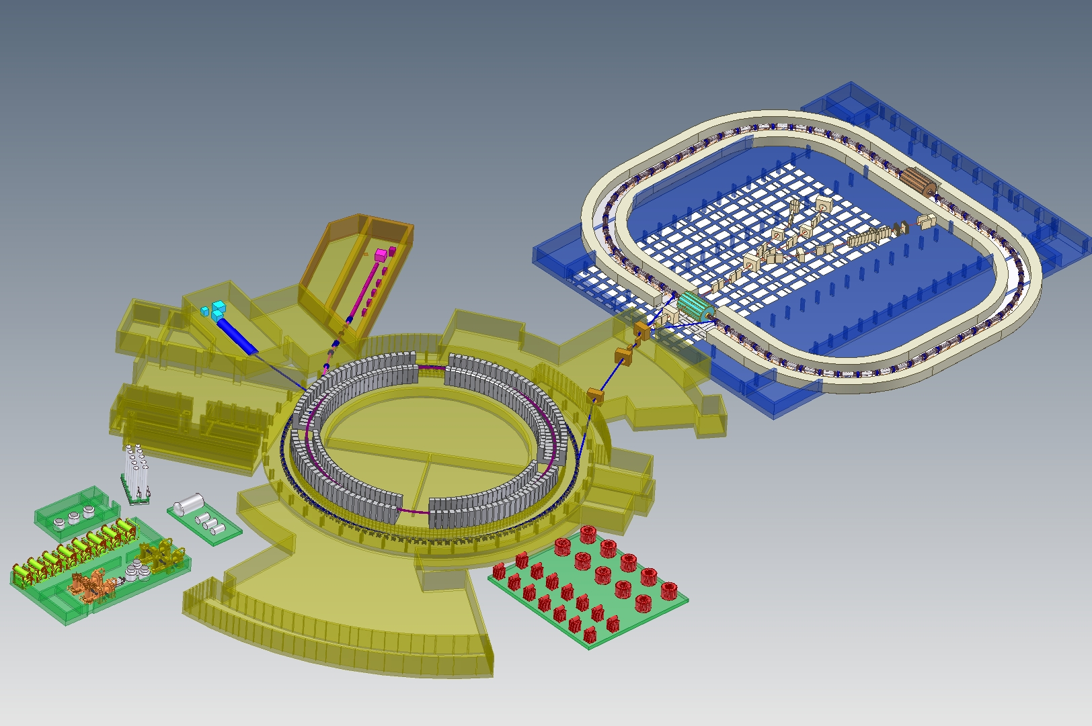
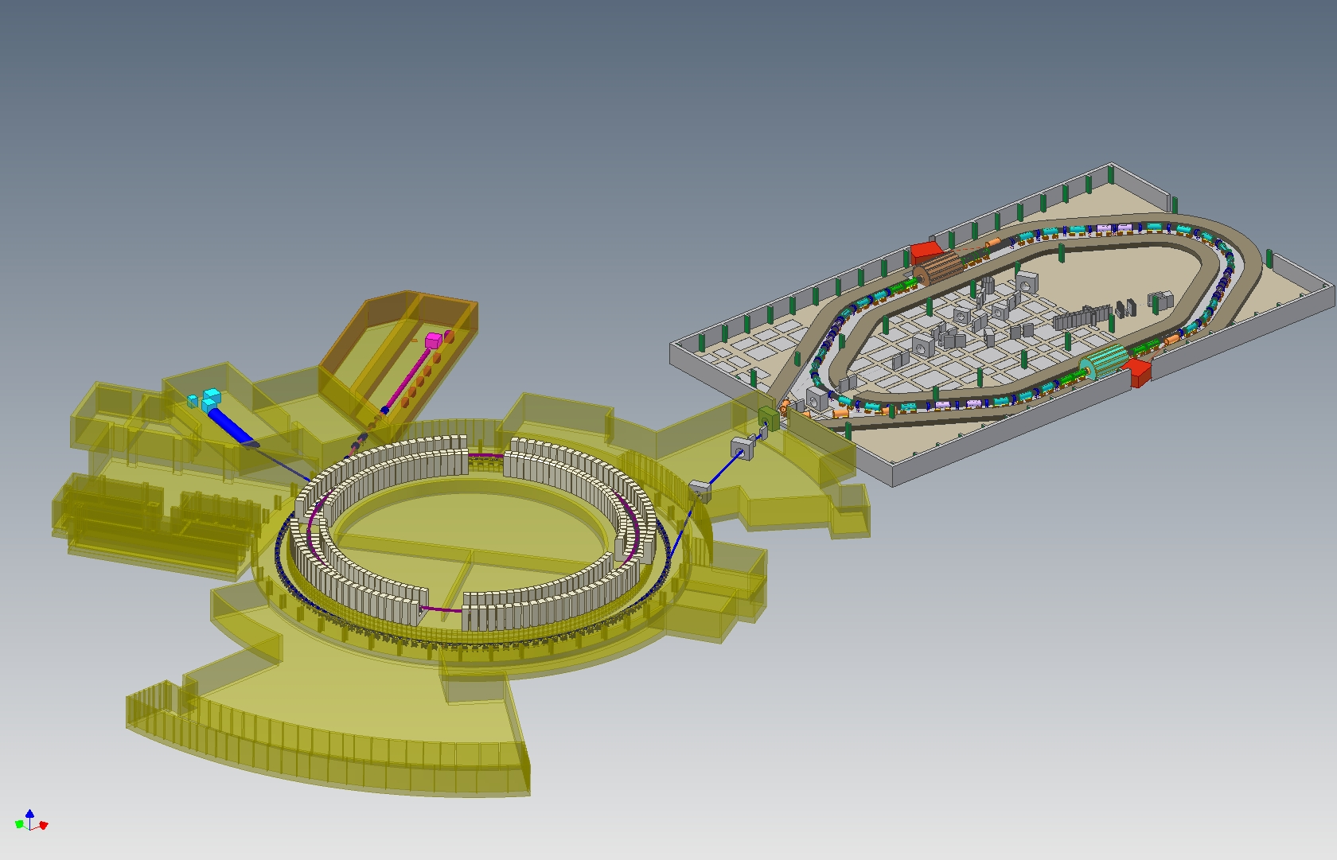
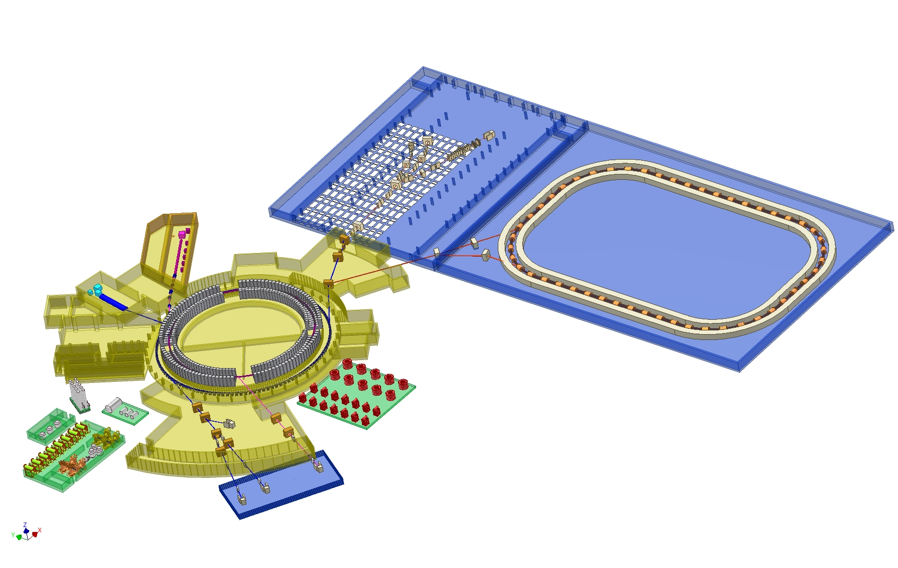
The Versions of The NICA Collider Project
Three first versions
Collider 4T
(CRing = 251.5 м)
September 2009
Collider
2T - 350
(CRing = 350 m)
February 2010
Collider
2T- 534
(CRing = 534 m)
July 2010

Slide 23
2nd IP
Notes:
23

Slide 24

Collider parameters
Peak luminosity can be estimated as:
Ring circumference, m | 503,04
Number of bunches | 23
Rms bunch length, m | 0.6
Beta-function in the IP, m | 0.35
Ring acceptance (FF lenses) | 40 π mm mrad
Long. acceptance, dp/p | ±0.010
Gamma-transition, γ_{tr} | 7.091
Ion energy, GeV/u | 1.0 | 3.0 | 4.5
Ion number per bunch | 2.75∙10⁸ | 2.4∙10⁹ | 2.2∙10⁹
Rms momentum spread, 10⁻³ | 0.62 | 1.25 | 1.65
Rms beam emittance, h/v, (unnormalized), π⋅mm⋅mrad | 1.1/ 1.01 | 1.1/ 0.89 | 1.1/ 0.76
Luminosity, cm⁻²s⁻¹ | 1.1e25 | 1e27 | 1e27
IBS growth time,sec | 186 | 702 | 2540
The collision repetition rate:
Hour-glass effect ~ 1 ( because in our case σs << β*):
Maximum luminosity is reached when the bunch phase volume corresponds to the ring acceptance

Slide 25
Colliders and fixed target experiments
Luminosity
Luminosity is a parameter of an experiment with particle beams equal to event number per time unit (rate) if the process under study has cross section of σ =1.
Luminosity is measured in cm⁻²⋅s⁻¹.
for colliding beams
for fixed target experiment
N₁, N₂ – particle number in colliding beams, S – maximal cross-section of two beams, f – frequency of collisions (for collider - particle rvolution frequency in the ring);
n₀ – target density (cm⁻³), l – target thickness, dN/dt – particle flux bombarding the target.

Slide 26
Luminosity
Limitation by particle rate production
- Total cross-section of particle losses
Effective use of the beam: σ_{reaction} ~ σ_{loss}

Slide 27
Maximal achievable luminosity, average
Examples:
NICA: Ion generation rate: 10⁹ per 4 seconds, reaction cross-section = 7 barn
RHIC (100 GeV/u), cross-section ~ 219 barn
L_{max} ~ 5⋅10²⁹ cm⁻² s⁻¹
CBM (FAIR)
Acceleration at SIS300 up to 10¹⁰ U ions, extraction during 10 sec
L_{max} ~ 10³² cm⁻² s⁻¹
PANDA (FAIR)
Antiproton production rate 10⁷ / sec, cross-section 0.05 barn
L_{max} = 10⁷/5·10⁻²⁶ = 2·10³² cm⁻² s⁻¹

Slide 28
Cycle parameters limitations
RHIC
Filling of both rings
And acceleration up to E_exp ~ 15 min
Experiment duration (L_lifetime) ~ 4 hours
L_{max} ~ 1.2⋅10³⁰ cм⁻² с⁻¹ *1/4 /4 ~ 8⋅10²⁸ cm⁻² s⁻¹
Average luminosity RHIC 10²⁸ cm⁻² s⁻¹ –
During experiment decreases by 20-30%
Due to stochastic ooling it is planned to increase luminosity by several times
This will require more intensive collider filling (more often)

Slide 29
NICA
It is planned to fill both rings during 200 sec,
Experiment (luminosity) lifetime ~ 2000 sec
L_{max} ~ 3.6⋅10³¹ cm⁻² s⁻¹ *2 /20 ~ 3.6⋅10³⁰ cm⁻² s⁻¹
At designed luminosity 10²⁷ cm⁻² s⁻¹ and stabilization of beam emittances due to beam cooling, the luminosity of experiment is practically constant
(if main loss mechanism is defined by interaction at Collision Point)
Limitation to the experiment characteristical time is connected to losses
due to interaction with residual gas
NICA Injection chain is designed with reserve of k~ 50

Slide 30
Limitations caused by Detector possibilities (event count)
Each detector sub-system has technical limitations on event count and registration
Rate of MPD is 7 kHz
In the fixed target experiment we can control optimal detector load by varying width of the target.
But during energy scan the geometry of the reaction products changes

Slide 31
Luminosity for fixed target experiment
Luminosity for internal target experiment
ρ - target width in atoms per cm²
First colliding beam is internal target for the second beam in the collider

Slide 32
Collider luminosity
For colliding bunches
x
v₂
v₁
σ_{x}
σ_{z}
σ_{y}
z
y

Slide 33
For similar round-shape bunches colliding at zero angle:
to increase number of bunches -> parasitic collisions;
to increase bunch current -> coherent instability;
to decrease emittance (bunch size) –> incoherent tune shift -> resonanses;
to decrease IP beta-function -> severe demands to FF QL, chromaticity;
to increase rev. frequency -> to decrease circumference (no space for equipment)
to have optimal bunch length (“hour-glass” effect).

Slide 34
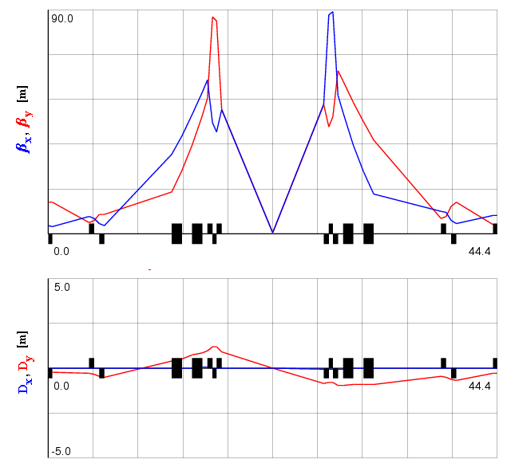
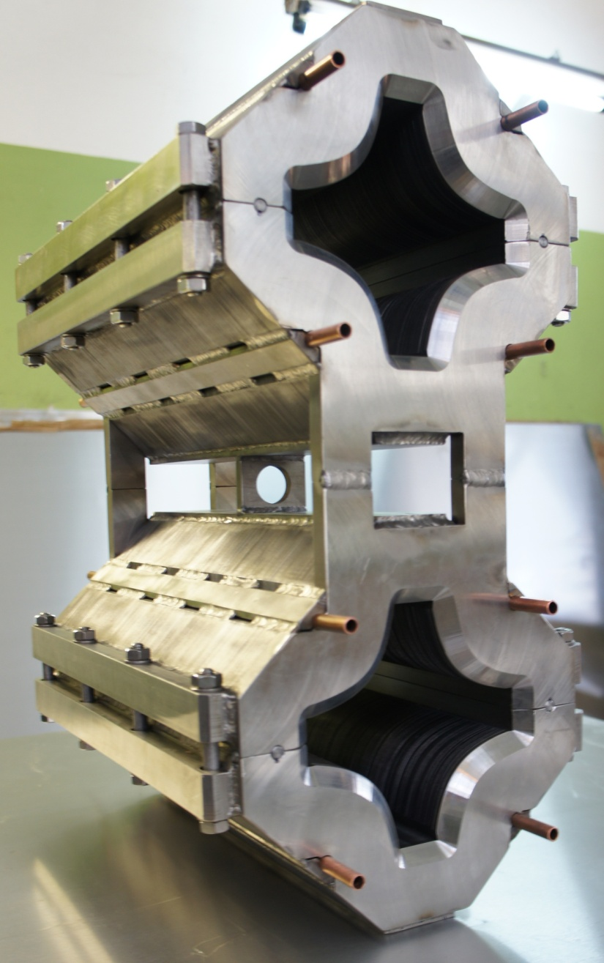
Example of the optic structure in the IP region
Max.beam size
Another limitation:
«electron clouds» effect: ion beam losses due to interaction with secondary electron avalanches from vacuum chambers walls
l_{min}

Slide 35

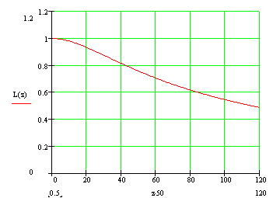
Bunch length
Hour-glass effect
β* = 0.5 m

Slide 36
Space charge effect limitations to Luminosity
Beam-beam effect and incoherent tune shift
Bunch-by-bunch
injection
N_{b} = const
Accumulation in
collider

Slide 37
 | RHIC | NICA
Circumference, m | 3800 | 503
Bunch spacing, m | 3800/120 = 32 (electron clouds, injection, parasitic collisions) | 15 (distance between dipoles)
Beta-function at IP | 5 | 0.35
Distance from IP to FFL | 50 | 5
3.5 GeV/u
RHIC < 10²⁵ cm⁻²s⁻¹
NICA ≥ 10²⁷ cm⁻²s⁻¹

Slide 38
IntraBeam scattering (IBS)
Single scattering on large angles – Touschek effect
IBS leads to 3 independent effects:
-“Maxwellisation” of the distribution fuction;
Equal energy swaping between all 3 degrees of freedom
Increasing of the 6D phase volume
Why IBS differs from situation when molecules interact? -
Cyclic accelerators because of curvature sections (arcs, etc) have Dispersion.
Due to Dispersion the variation of the longitudinal coordinate leads to
The variation of transverse oscillation amplitude.
By other words transverse and longitudinal motion are coupled.
There is no way to keep Luminosity without beam cooling !!!

Slide 39

Luminosity life-time
Without beam cooling - beam emittance grows due to intra-beam scattering
Characteristic time of the luminosity decrease rate
~ several minutes (at RHIC operating with 100 GeV/u ~ 4 hours)
RHIC:
Construction of the Electron cooling system at low energy ions (< 5 GeV/u),
Stochastic cooling is used at maximal energy.
NICA:
Electron + stochastic cooling during beam stacking,
Electron + stochastic cooling during the experiment (collision mode)

Slide 40
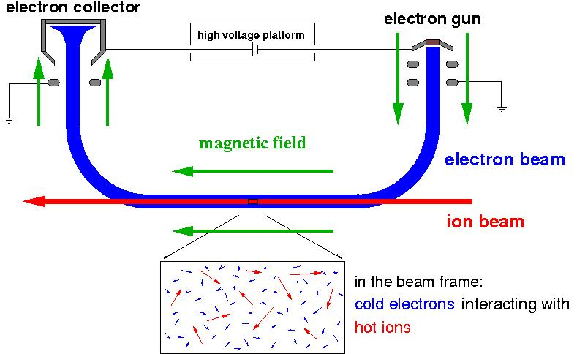
Electron Cooling
v_{e//} = v_{i//}
E_{e}=m_{e}/M_{i}⋅E_{i}
e.g. :220 keV electrons cool 400 MeV/u ions
electron temperature
k_{B}T⊥ ≈ 0.1 eV
k_{B}T// ≈ 0.1 - 1 meV
superposition of a cold intense electron beam with the same velocity
momentum transfer by Coulomb collisions
cooling force results from energy loss in the co-moving gas of free electrons
Courtesy to M.Steck

Slide 41
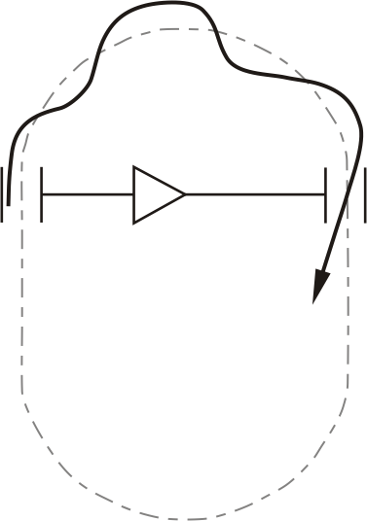
Stochastic Cooling
First cooling method which was successfully used for beam preparation
S. van der Meer, D. Möhl, L. Thorndahl et al.
Conditions:
Betatron phase advance (pick-up to kicker): (n + ½) π
Signal travel time = time of flight of particle (between pick-up and kicker)
Sampling of sub-ensemble of total beam
pick-up
kicker
amplifier
Principle of transverse cooling:
measurement of deviation from ideal orbit
is used for correction kick (feedback)
Courtesy to M.Steck

Slide 42
The problems we have met and the solutions
The problems:
Beam space charge effects
Beam-beam effects
IntraBeam scattering (IBS) ⇒ luminosity degradation
The solutions:
Electron cooling application
Stochastic cooling application
Beam parameters choice
Operation scenario optimisation
Recombination in e-cooler
Bunch halo formation ⇒
⇒ parasitic collisions, background growth
Scrappers and collimators

Slide 43
Two regimes and cooling methods: injection & storage
Injection periodicity
Requirement:
τcool ≤ 10 sec << τrecombination ~ 480 sec (for e-cooling)
τcool(Ei, Te⊥, B)
τrecombn(Ei, Te⊥)

Slide 44
Two collider regimes
1. Facility structure and operation regimes
Electron cooling application! (N_ion)bunch ≤ 2E9!
τrecombination , sec
Ni
Ion/bunch,
1E9
(τIBS)x, y , sec
Tx = 2.5 eV
Bsol = 1 kG
ε, 1E-4
π⋅mm⋅mrad
(τcool)x , sec
Luminosity
1E27 cm⁻²⋅s⁻¹
Ei – ion energy,
GeV/u

Slide 45
Collider parameters
Parameter | Value
Circumference, m | 503.04
Max. magnetic rigidity, T⋅m | 45.0
Max. magnetic field, T | 1.8
Acceptance, π⋅mm⋅mrad | 40.0
Longitudinal acceptance (Δp/p) | ± 0.01
Number of dipole magnets | 80
Collider
FODO, 12 cells x 90º each arc,
γ_{tr} = 7.091 , β * = 0.35 m (variable)

Slide 46
Two regimes and cooling methods: injection & storage
1. Facility structure and operation regimes
Questions:
1. What kind of storage method?
Barrier Bucket method with electron cooling application!
2. What about storage with stochastic cooling application?
Problems below 2.5 GeV/u ⇒ studies in progress…
3. What kind of acceleration system is proposed?
Barrier Bucket system.

Slide 47
Proposed Scheme of Ion Stacking and Bunch Formation in The Collider
Barrier RF system (1-st RF)
accumulation
barriers are switched off
coasting beam
2-nd RF system (h=C/21.5m)
1/3
All stages are provided with cooling
bunching with adiabatic RF increase
Stop at length of 1/3 of bucket
3-d RF system (h=h2x3)
rebucketing adiabatic RF increase
bunch has final parameters

Slide 48
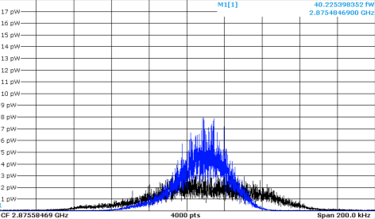
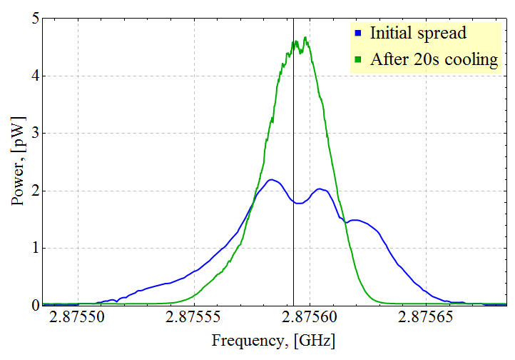
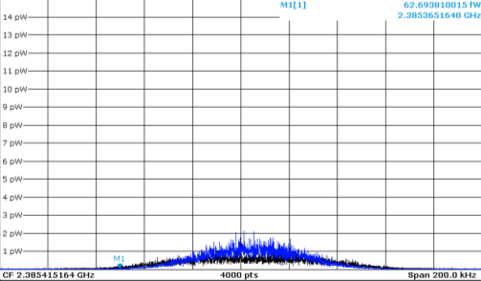
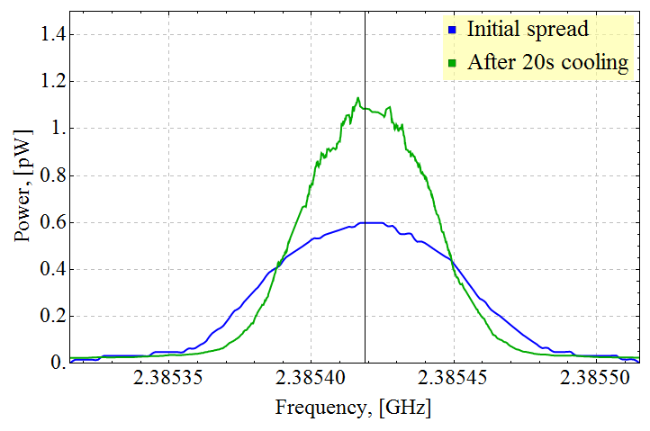
Stochastic cooling of the carbon beam 2.5 GeV/u
Spectrum analyzer
Computer reconstruction
Coasting beam
Bunched beam
σ_{s} = 4.2 m
RF voltage of 2 kV at plateau duration up to 25 sec,
bunching factor (peak/mean current) ~ 5 (for NICA ~ 15)
Nearest plans: heavy ions, large bunching factor
48

Slide 49
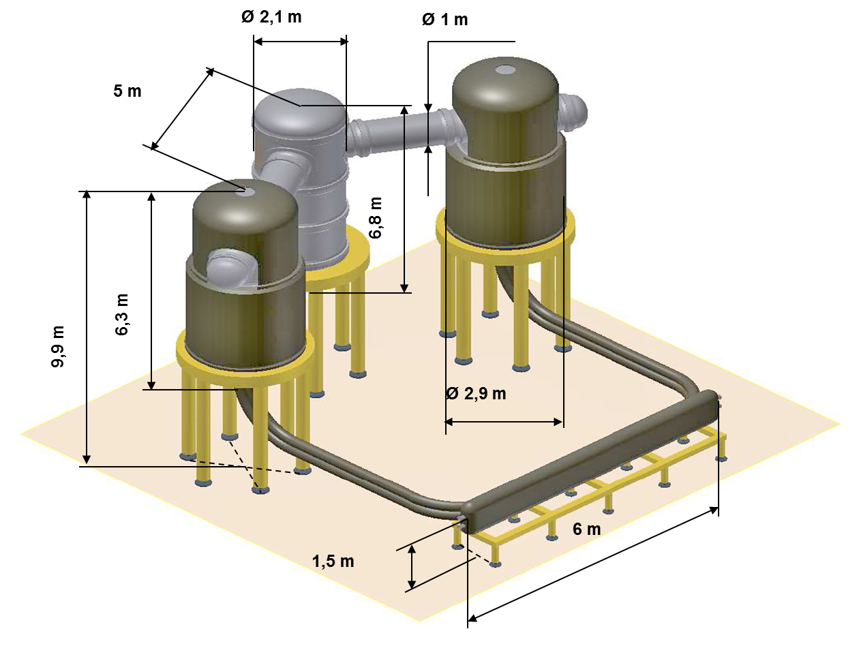

Collider Electron cooling
Maximum electron energy, MeV | 2.5
Cooling section length, m | 6.0
Electron beam current, A | 0.5-1
Electron beam radius, cm | 1
Magnetic field in cooling section, T | 0.1-0.3
49

Slide 50
NICA MAC October 17-18, 2013
3. Start configuration of The NICA Accelerator Complex
No electron cooling system
Reduced (initial) version of stochastic cooling system
Reduced version of RF system consisting of
- Barrier bucket RF system
- RF-2 or RF-3 reduced systems (to be decided)
Operation in the ion energy range of 3.0 ÷ 4.5 GeV/u
Disadvantage: beam intensity will be much lower of design value;
Advantage: at low beam intensity one can neglect with parasitic collisions in the straight sections!

Slide 51
Startup version of the collider
Energy range from 3 to 4.5 GeV/u (optimum ~ 3.5 GeV/u)
Operation scenario:
Stacking with BB + Stoch. longitudinal cooling
Bunching at h = 22 and Stoch. longitudinal cooling
Bunch length is about 1.2 m (instead of 0.6 m)
Momentum spread of 4.2⋅10⁻⁴ (instead of 1 ⋅10⁻³)
Bunch intensity 5 ⋅10⁸ (instead of 2 ⋅10⁹)
Luminosity (1÷7) ⋅10²⁵ cm⁻²s⁻¹
Parameters

Slide 52


Fast Ramped S.C. Magnets
R&D Goals
Reduction of eddy / persistent current effects
at 4K (3D field, AC loss)
Improvement of DC/AC-field quality
Guarantee of long term mechanical stability (≥ 2⋅10⁸ cycles )
B_field error at R= 30 mm ≤ 2⋅10⁻⁴
Activities
AC Loss Reduction (exp. tests, FEM)
2D/3D Magnetic Field Calculations (OPERA, ANSYS, etc.)
Mechanical Analysis and Coil Restraint (design, ANSYS)
(>Fatigue of the conductor and precise positioning)
Experimental studies with modified Nuclotron magnets in JINR

Slide 53


Collider magnets construction
Test on vacuum tightness of the tubes for cooling the yoke
31/34

Slide 54







Full-scale Nuclotron–type superconducting model dipole and quadrupole magnets for the NICA booster and collider were manufactured at Laboratory of High Energy Physics JINR. First dipole and quadrupole magnets for the NICA booster have successfully passed the cryogenic test on the bench. 3 pre-serial dipole magnets for the NICA booster will be manufactured and tested this year. Serial production of the magnets for the booster is scheduled for 2014. Cryogenic tests of the model twin aperture dipole and quadrupole magnets for the NICA collider are scheduled for the first half of this year.
Sextupole corrector prototype (for SIS100 and NICA booster) at assembly
Booster dipole at cryo-test (9690A) and magnetic measurements
Twin aperture dipole magnet for Collider was tested June 2013 up to 11 kA

Slide 55





Excellent co-operation:
JINR is responsible for delivery of 175 Quadrupole Units for SIS-100.
Collaboration Contract is prepared. It will include: manufactury, assembly cold testing of all QU’s. Investments from BMBF to JINR to the dedicated Test Facility which will be used for assembly and testing of SC magnets both for NICA and FAIR
First step: R&D Contract for equipment of the Test Facility signed between GSI and JINR in Dec’2013.
Intelligent equipment for cold measurements of the magnetic field in SC magnets is developed in Dubna and in Darmstadt. We exchange with technologies and experience (V.Borisov, P.Schnitzer, H.Khodzhibagiyan, E.Fischer, S.Kostromin, A.Donyagin)

Slide 56




SC magnets assembly and test area (b.217):
cooperation with German centers
Workshops for SC coil production
56

Slide 57











On-line web-camera
http://betacool.jinr.ru/b/
30 Dec 2013
On-line web-camera
http://betacool.jinr.ru/b/
57

Slide 58




Already signed agreements in cooperation with:
CERN
GSI
State committee in science
& technology of Belarus
Kurchatov Federal Center
Institute for Nuclear Research RAS
Moscow State University
Budker Institute of Nuclear Physics RAN
Tsinghua University, China
Institute of Plasma Physics CAS, China
University of Science and
Technology of China
and others
58

Slide 59
NICA accelerator complex - I
Linac HILac
KRION
Booster (25 Tm)
1(2-3) single(multi)-turn injection,
storage of 2 (4-6)×10⁹,
acceleration up to 65 MeV/u,
electron cooling, acceleration
up to 600 MeV/u
Stripping (80%) ¹⁹⁷Au³¹⁺ => ¹⁹⁷Au⁷⁹⁺
Nuclotron (45 Tm)
injection of one bunch
of 1.1×10⁹ ions,
acceleration up to
1 - 4.5 GeV/u max.
Two SC
collider rings (Au x Au ions)

Slide 60
…What NEXT ?...

Slide 61
Motivation:
“Experiments with spin have killed more theories than any other single physical parameter.” (J.D.Bjorken)
[Cited by Elliot Leader, “Spin in Particle Physics”, Cambridge Univ. Press, 2001]

Slide 62
NICA – II accelerator complex
Linac LU-20
⬆ p,d
sources
Booster (25 Tm)
acceleration
up to 1 GeV/u
Nuclotron (45 Tm)
acceleration up to
1 – 11 GeV max.
Two SC
collider rings (⬆p x ⬆p)
√s_{pp} = 25 GeV

Slide 63
NICA - III accelerator complex
Linac HILac
KRION
Booster 25 T•m
Merging bare
U²³⁵ beams
E~ 0,6GeV/u
Two SC
Rings
~11 T•m
Stripping (80%) ¹⁹⁷Au³¹⁺ => ¹⁹⁷Au⁷⁹⁺
Nuclotron 45 T•m
Two SC
collider rings

Slide 64
Heaviest atoms in QED
Hg
(point charge)
SHE
Yu. Oganessian 2013
Z_{max}=1/α=137
(finite size)
where α is fine-structure constant
Z_{max}≈173

Slide 65



SHE-Factory
Yu. Oganessian 2013
r_{max} - principal maximum
of the wave function
of the outermost orbital
Collider NICA
Z_{max}

Slide 66

NICA
NICA
RINGS
SIMULATION OF
THE SUPERHEAVY ATOM
ΔE_{LAB}= 2 GeV·A
U⁹²⁺
U⁹²⁺
merging beams
Z=184⁺
U
Z=92⁺
Z=92⁺
U
U⁹²⁺
ΔE_{CM}= 5-6 MeV·A
U³⁵⁺
e⁻
BUSTER
NUCLOTRON
e⁺
U⁹²⁺
Z=91⁺
U
U
empty
K-shell
Z=91⁺
e⁻
e⁺
Yu. Oganessian 113-th Session of the Scientific Council of JINR, Feb.21, 2013, Dubna

Slide 67
NICA - IV accelerator complex
Linac HILac
KRION
Booster (25 Tm)
acceleration
up to 600 MeV/u
Nuclear physics:
e- beam is scan for heavy nuclei PDF
Stripping
Target
Mass-separator
Nuclotron (45 Tm)
acceleration up to
1 - 4.5 GeV/u max.
Radioactive ions
Two SC
collider rings:
e- (1 GeV) x i (1 GeV/u)
e-
SC e-Linac (30 MV/m)

Slide 68



Cos-ϕ Dipoles
Block number | 5
Turn number/quadrant | 34 (17+9+4+2+2)
Operating current | 8924 A
Yoke inner radius | 98 mm
Peak field on conductor (with self field) | 4.90 T
Bpeak / Bo | 1.09
Working point on load line | 69%
Current sharing temperature | 5.69 K
Inductance/length | 2.9 mH/m
Stored energy/length | 116.8 kJ/m
Discorap-Project by INFN
Magnet finished in 2010

Slide 69

NICA-V accelerator complex
SC p-linac (10MV/m)
p-source
Booster (25 Tm)
Acceleration
up to
~ 1,3 GeV/u
Two collider rings
SC magnets ~ 5 T;
~ 100 T⋅m
E ~ 30 GeV (p)
Intensity ~ 1e13
Extracted high-intense p-beam
Nuclotron
45 Tm
E ~ 12 GeV
μ-target
Goal: MW proton beam to the target

Slide 70
Dubna
ν_{e}->ν_{μ}->ν_{τ}
~ 4500 km
Baikal

Slide 71


Nikola Camille Flammarion (1888)

Slide 72

Спасибо за внимание !
My gratitude to: I.Meshkov, A.Sidorin, V.Kekelidze, A.Sorin, Yu.Oganessian et al for slides.

Slide 73
Introduction
B) Polarized Beams – Particle Spin Physics
The problem => Nucleon quark structure and nucleon spin
First hypothesis: 3 quarks are polarized in such a way that
Spin (p↑) = (u↑ u↑ d↓) = ↑ ≡ 1/2
However:
HERMES experiment at HERA e↑х p-collider
(DESY Lab., 1995 – 2007):
Not more 30% of proton spin can be explained with constituent
quarks, i.e. Nucleon spin ≠ Σ S_{quark}
Modern hypothesis:
S_{nucleon} = ΣS_{quark} + ΣS_{gluon} + ΣL_{quark} + ΣL_{gluon} ,
L – orbital momentum of the quark/gluon

